Slide 1
Software Testing
Zeeshan Ali Rana

Slide 2
Software Faults and Failures
Why Does Software Fail?
Fault (bug):
Programming or design error whereby the delivered system does not conform to specification (e.g., coding error, protocol error)
Failure:
Software does not deliver the service expected by the user (e.g., mistake in requirements, confusing user interface)

Slide 3
Software Faults and Failures
Why Does Software Fail?
Wrong requirement: not what the customer wants
Missing requirement
Requirement impossible to implement
Faulty design
Faulty code
Improperly implemented design

Slide 4

Objective of Testing
Objective of testing: discover faults
A test is successful only when a fault is discovered
  Fault identification is the process of determining what fault caused the failure
  Fault correction is the process of making changes to the system so that the faults are removed

Slide 5
Elements of a Test Case
Purpose
Input
Expected Output
Actual Output
Sample Format:
Test Case ID | Purpose | Input Data | Expected Output | Actual Output | Result

Slide 6
Types of Faults
Algorithmic fault (logic)
Computation and precision fault
  a formula’s implementation is wrong
Capacity or boundary faults
  System’s performance not acceptable when certain limits are reached
Timing or coordination faults
Performance faults
  System does not perform at the speed prescribed

Slide 7
Software Faults and Failures
Typical Algorithmic Faults
An algorithmic fault occurs when a component’s algorithm or logic does not produce proper output
  Branching too soon
  Branching too late
  Forgetting to initialize variable or set loop invariants
  Comparing variables of inappropriate data types

Slide 8
Different Level of Failure Severity
Catastrophic: causes death or system loss
Critical: causes severe injury or major system damage
Marginal: causes minor injury or minor system damage
Minor: causes no injury or system damage

Slide 9
Testing Issues
Who Performs the Test?
Independent test team
  avoid conflict
    personal responsibility vs need to discover faults
  improve objectivity
  allow testing and coding concurrently

Slide 10
Testing Issues
Views of the Test Objects
Closed box or black box: functionality of the test objects
  Equivalence Class, Boundary Value Analysis, Scenario-based, Decision Table based, State Machine based…
Clear box or white box: structure of the test objects
  Control Flow
    Basis Path, Branch, Statement, Decision…
  Data Flow
    Du Path, All-uses Path

Slide 11
Test Cases for Triangle Problem
Test cases based on input range
TC Id | What to test | A | B | C | EO
1 | EC1 of A | -10 | 15 | 15 | Value of A not in valid range
2 | EC1 of B | 15 | -10 | 15 | Value of B not in valid range
3 | EC1 of C | 15 | 15 | -10 | Value of C not in valid range
4 | EC3 of A | -205 | 15 | 15 | Value of A not in valid range
5 | EC3 of B | 15 | -205 | 15 | Value of B not in valid range
6 | EC3 of C | 15 | 15 | -205 | Value of C not in valid range
7 | EC2 of A, B, C | 15 | 15 | 15 | Equilateral
Note that we have made only one test case instead of three separate test cases to check ABC in valid range. This one test could be any test cases with any valid combination of A, B, C; for example see any of the valid range based test cases.
Test cases based on equivalence classes within valid range
TC Id | What to test | A | B | C | EO
1 | EC 1 | 15 | 15 | 15 | Equilateral
2 | EC 2 | 10 | 20 | 10 | Isosceles
3 | EC 3 | 5 | 6 | 7 | Scalene
4 | EC 4 | 1 | 2 | 10 | Not a triangle

Slide 12
Whitebox Testing
Control Flow Graph
Cyclomatic Complexity = E – N + 2 = 9 – 9 + 2 = 2
Statement testing
Branch testing
Path testing
…

Slide 13
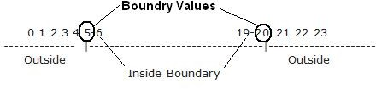
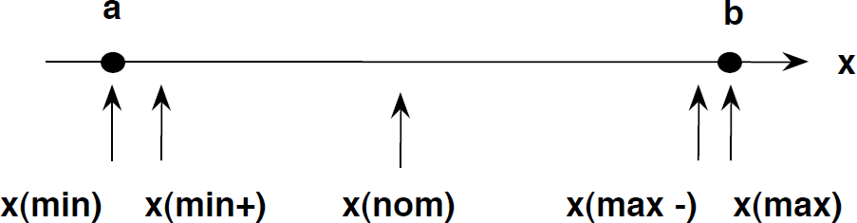
Boundary Value Analysis

Slide 14
Example
An Address text box which allows maximum 500 characters. So, writing test cases for each character once will be very difficult so that will choose boundary value analysis.

Slide 15
Example
An Address text box which allows maximum 500 characters. So, writing test cases for each character once will be very difficult so that will choose boundary value analysis.
No character
1 character
2 characters
499 characters
500 characters
501 characters

Slide 16
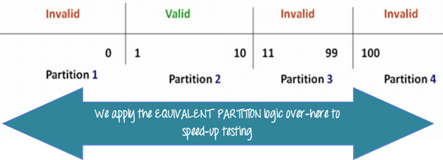
Equivalence and Boundary Value
Let's consider the behavior of Order Pizza Text Box Pizza values 1 to 10 is considered valid. A success message is shown.
Here is the test condition
Any Number greater than 10 entered in the Order Pizza field(let say 11) is considered invalid.
Any Number less than 1 that is 0 or below,
then it is considered invalid.
Numbers 1 to 10 are considered valid Any 3 Digit Number say -100 is invalid.

Slide 17
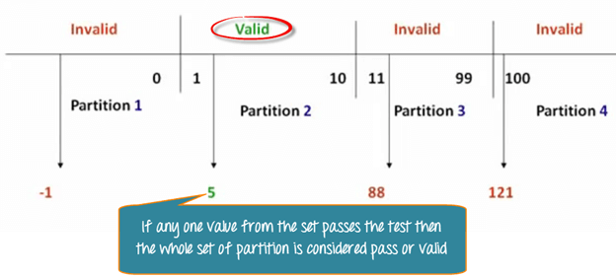
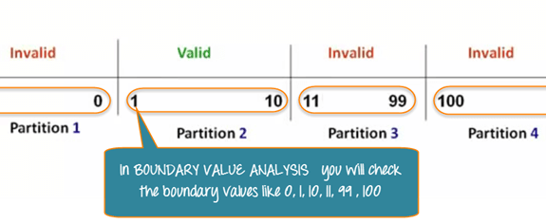
Equivalence and Boundary Value

Slide 18
Levels of Testing
Module testing, component testing, or unit testing
Integration testing
System Testing
  Function testing
  Performance testing
Acceptance testing
Installation testing

Slide 19
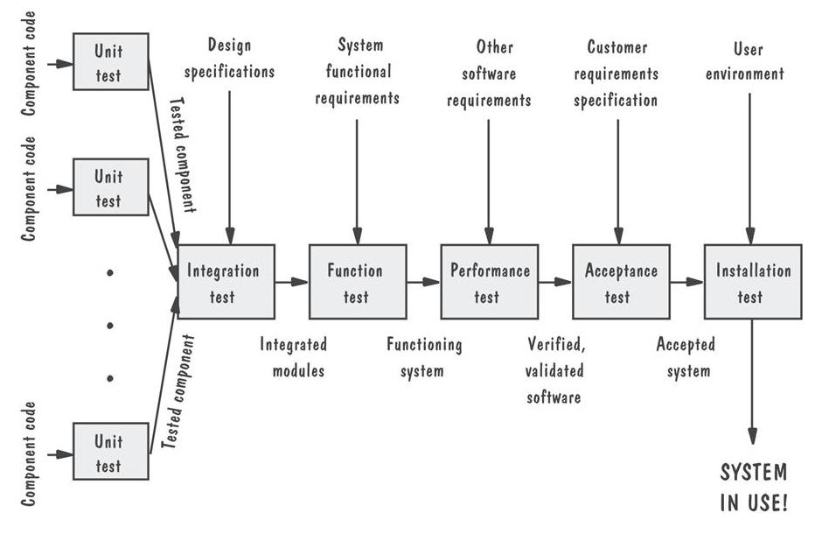
Levels of Testing
Testing Organization Illustrated

Slide 20
Software Testing Tools
Automated Testing Tools
  Selenium, QTP, SilkTest, WinRunner, LoadRunner, Jmeter
Testing Management Tools
  TestManager, TestDirector
Bug Tracking/Configuration Management Tools
  Bugzilla, Jitterbug, SilkRadar

Slide 21
When to Stop Testing
No time left
No money left
Statistical Criteria
  Number of defects found per week becomes lower than a set threshold

Slide 22
References
UCF Slides
Software Testing, A Craftsman’s Approach by Jorgensen

